Slide 1


Welcome to the
REALTOR® Party
Your Voice
For Advocacy
Notes:
Welcome to the REALTOR® Party – your voice for advocacy.
As a new member of the National Association of REALTORS®, you are also a member of the REALTOR® Party—the only advocacy group in America that fights exclusively for homeownership, real estate investment, strong communities and the free enterprise system.
As you will see in this short video I’m about to show you, membership has its privilege.
Let’s watch…
(click to next slide and begin video)

Slide 2

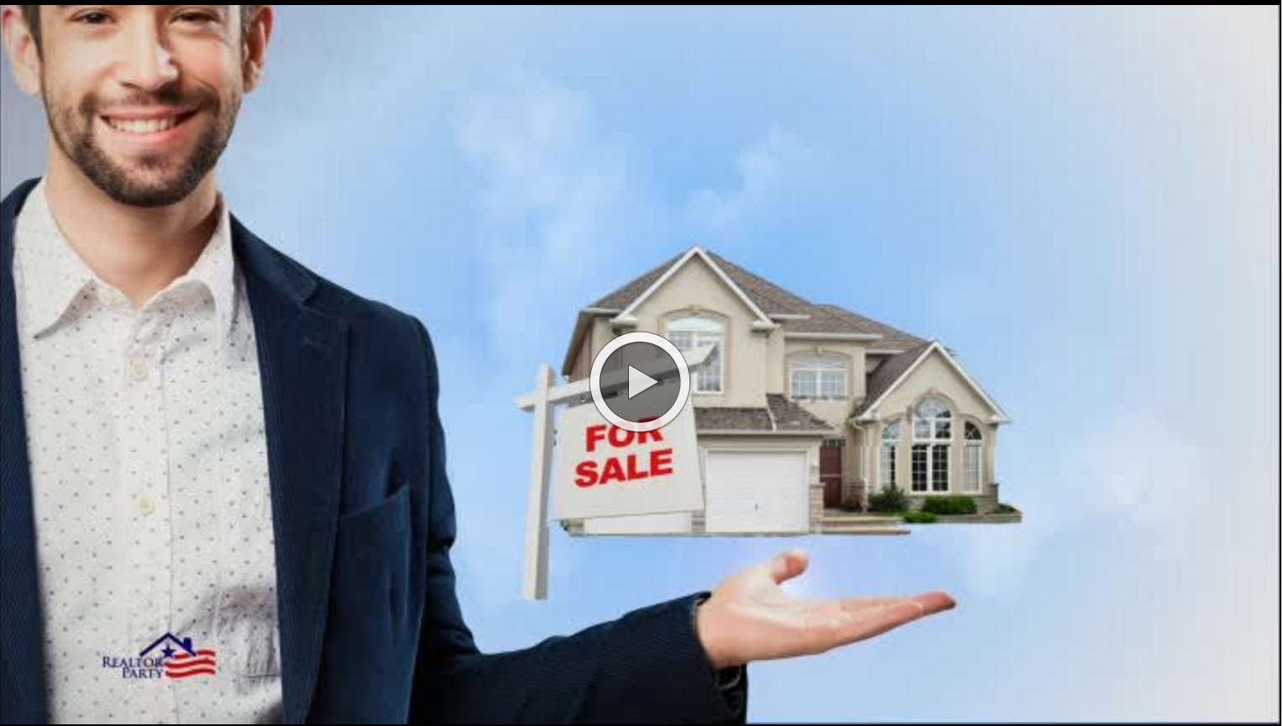

Slide 3

The REALTOR® Party
Works to Advance:
Home ownership
Property investment
Strong communities
Your business
Notes:
[Associations can customize with local issues]
While you are working hard helping your clients invest in property ownership, and ultimately their future, the REALTOR® Party has your back.
Whether it’s city hall, the state house or the U.S. Capitol, our mission remains the same. The REALTOR® Party speaks with one voice to advance candidates and public policies that uphold private property rights, real property ownership, strong communities and a vibrant business environment.
In recent years, our local level activities have increased; REALTORS® have gained political clout through legislative victories in every corner of the country; and state and local REALTOR® Associations have expanded their community and political presence…all because of the actions of the REALTOR® Party.

Slide 4

The REALTOR® Party
Works to Protect:
MID
Property Taxes
Sales Tax on Services
First-Time Home Buyer
Savings Accounts
Short-term Rentals
Notes:
[Associations can customize with local issues]
At the same time, the REALTOR® Party has been working to prevent policies and regulations that harm our business and the real estate industry.
Things like:
MID
Property Taxes
Sales Tax on Services
First-Time Home Buyer
Savings Accounts
Short-term Rentals
…to name a few.

Slide 5

The REALTOR® Party:
Elects REALTOR® Champions
Supports pro-real estate issues
Makes neighborhoods, cities and
townships stronger
Notes:
How does the REALTOR® Party accomplish these things?
By supporting candidates who support our issues.
By urging policymakers to support pro-real estate issues and running issue campaigns to support/defeat ballot initiatives, state constitution changes and more.
And through member-driven community activities and involvement that make our cities and neighborhoods stronger.

Slide 6
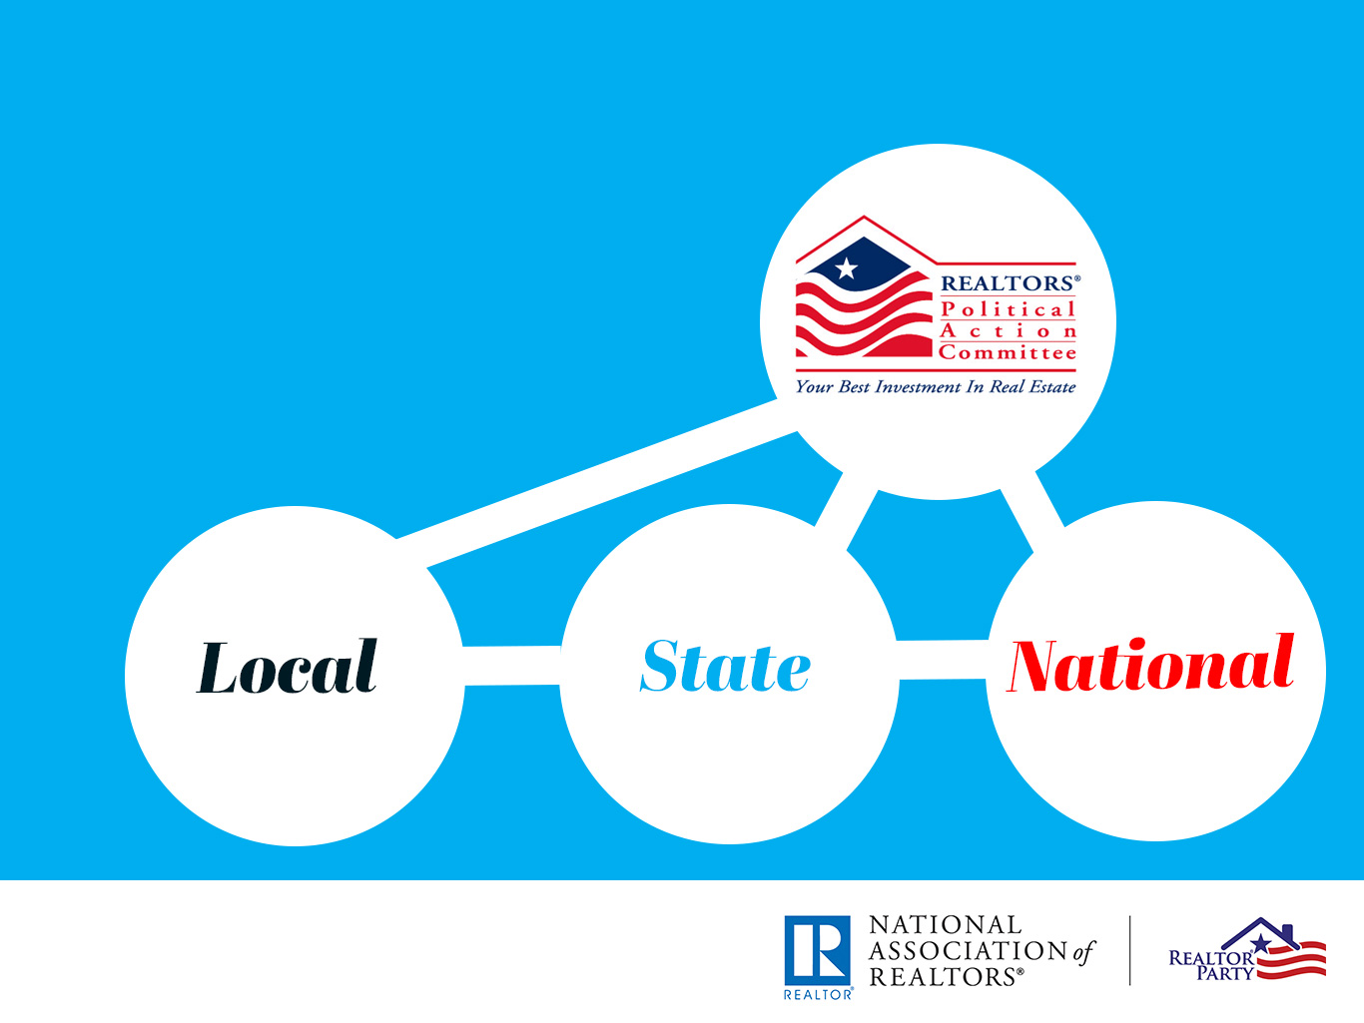
REALTOR® Party
and RPAC Work
Hand in Hand
Notes:
RPAC, the REALTORS® Political Action Committee, and the REALTOR® Party go hand-in-hand.
Funded by voluntary investments from members like you, they work together to elect REALTOR® Champions, who help to advance issues that matter to our industry and the nation’s property owners and to build strong communities.
This partnership is what makes us a force to be reckoned with at the local, state and national level.
But the REALTOR® Party goes beyond supporting candidates with money. Once elected to public office, we are there to communicate with all elected officials on issues that are important to our industry.

Slide 7
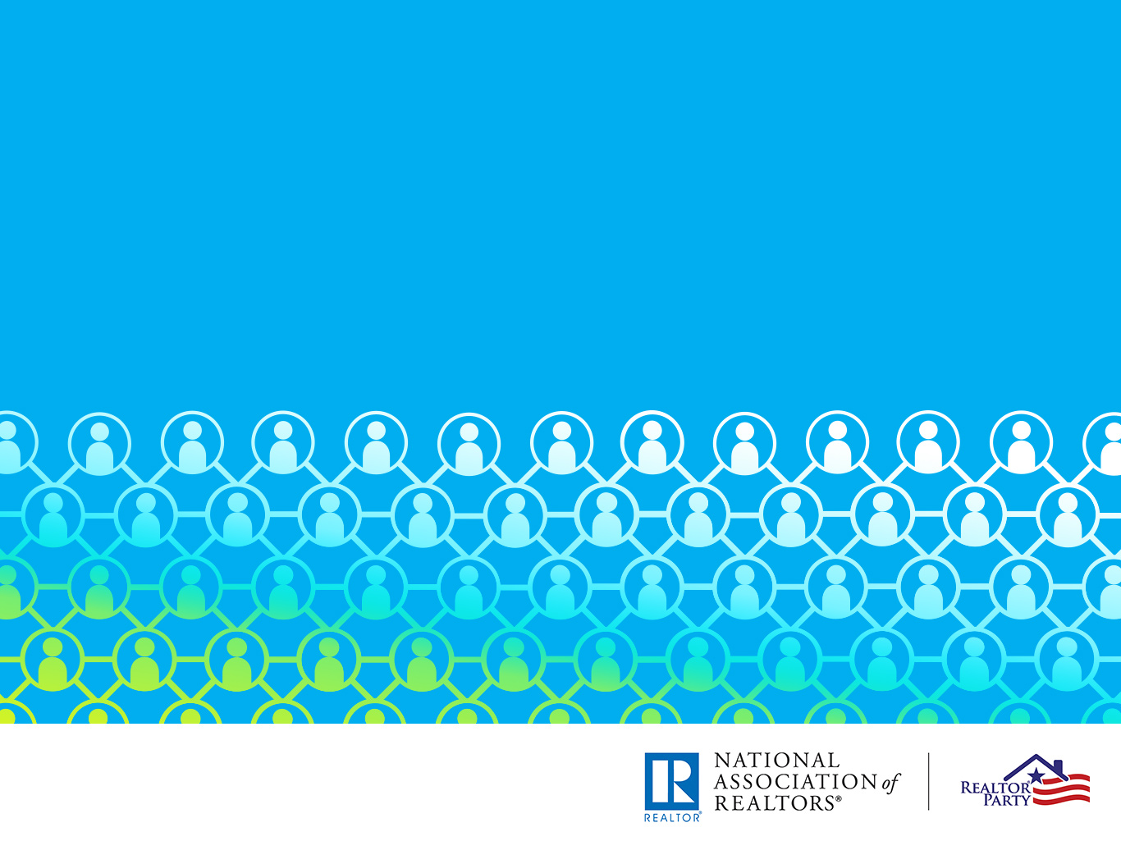
Not just politics …
Community Outreach and
Issue Engagement Too!
Notes:
More than politics, the REALTOR® Party is about community outreach and issue engagement, as well.
Since REALTORS® usually live in the same communities where they work, they doubly benefit from improving their communities.
That’s why it’s important that REALTORS® are active members of their communities and support issues that matter to real estate and our clients.

Slide 8

Placemaking:
Improving
Public Spaces
Dog parks
Play areas
Community gardens
Public art
Decorative park benches
Trails
Notes:
For example, our Placemaking Program helps to make public places and spaces better, or a place people want to go to.
This is an excellent way for REALTORS® and REALTOR® Associations across America to get involved with building community gardens, creating spaces for public artwork, installing park benches and much more.
The Placemaking Program is just one of more than 80 programs, services and resources offered by the REALTOR® Party.

Slide 9
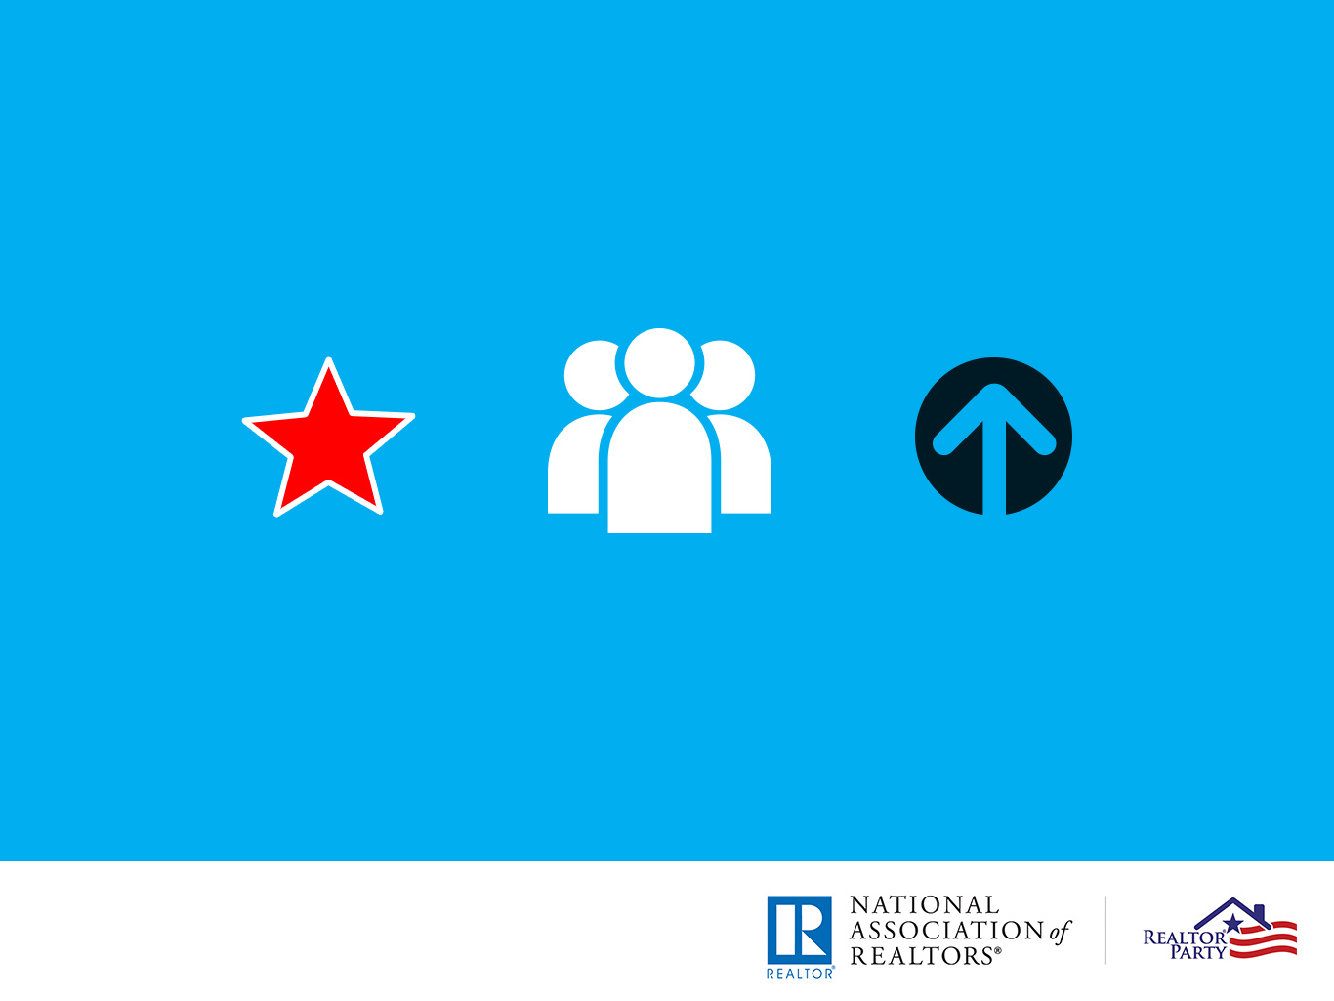
The Basics: What Can You Do?
Vote
Act
Invest
Notes:
Let’s bring the REALTOR® Party down to the basics—to what you can do as an individual REALTOR® to participate and make the REALTOR® Party strong.
It boils down to three simple, but important words:
Vote
Act, and
Invest

Slide 10

Vote!
Register to Vote
Go to the Polls – at every election!
Notes:
[Associations can customize with local statistics]
First, make sure you are registered to vote, especially if you have recently moved. It may startle you to know that 15 percent of our members are not registered – that’s nearly 225,400 REALTORS!
Here in (State Name), xx percent of REALTORS® are not registered–that’s more than XXXXX! (get your state’s voter registration numbers at: https://realtorparty.realtor/campaign-services/advocacy-voter-map.html)
There are voter registration tools available through the REALTOR® Party website at www.realtorparty.realtor.
And of course, don’t just register, go to the polls and vote!!!
REALTORS® should be the biggest activists in any community. Voting is the easiest way to make our voices heard.
In the last Presidential election, 73 percent of REALTORS® voted, compared with just under 60 percent of the general population. Isn’t that great that REALTORS® are leading the nation?

Slide 11

Act!
Get involved in our
REALTOR® Association
Respond to Calls for Action
Register for REALTOR® Party
Mobile Alerts
Notes:
Second, get involved in our local association. Serve on committees, participate in our advocacy and community outreach events. We need you.
Also, make sure you are responding to Calls for Action from the National Association of REALTORS® and the state association. Calls for Action send messages from you to your national and state legislatures about issues that are important to our business. There are one million REALTORS® across America, imagine how loud our collective voice would be if we ALL responded to Calls for Action.
And we’ve made it easy to do this through REALTOR® Party Mobile Alerts—our texting platform.
Be sure to sign up. In fact, let’s do it right now!

Slide 12

Sign up for REALTOR® Party
Mobile Alerts
Join tens of thousands
of fellow REALTORS®
and be the first to know
about Calls for Action!
Sign up now by
texting REALTOR
to 30644
Notes:
REALTOR® Party Mobile Alerts will alert you to Calls for Action on your phone.
If you haven’t already, I want you to pull out your phones right now and sign up. If you’ve already done it, help your neighbor.
(pull out your phone and hold it up)
Open up your phone and text the word REALTOR to 30644.
Again, that’s 30644. Text the word REALTOR. Boom–you’re in.

Slide 13

Invest!
Invest in RPAC
Become a Major Investor
Get your colleagues
to do the same
Notes:
[Associations can customize with candidates/issues your association has supported]
Third, invest in RPAC. Again, the REALTORS® Political Action Committee helps fund candidates that support our business on federal, state and local levels. That’s right! RPAC has an impact right here in our own community.
Nearly one third of our members nationwide invest in RPAC. That‘s nearly 32 percent.
But we can do better. I hope you step up to the plate.

Slide 14
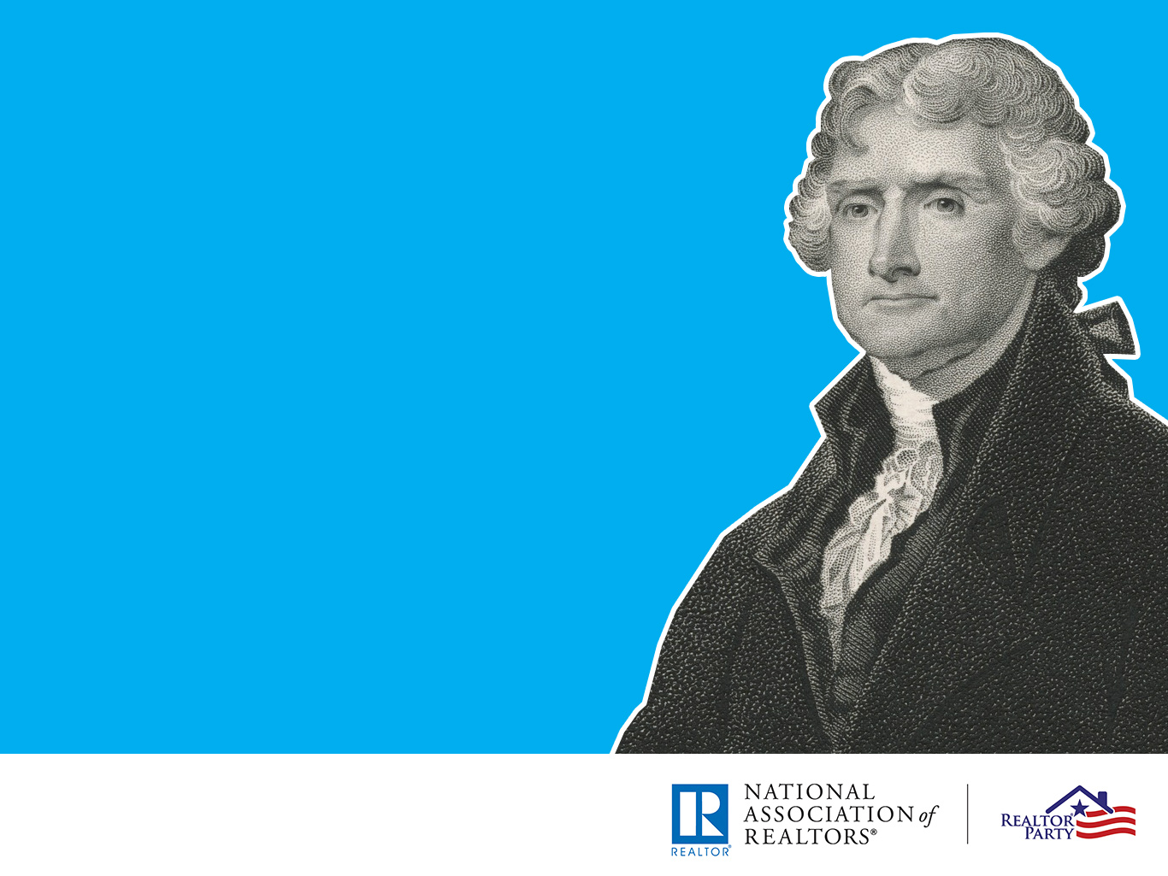
“We in America do not have
government by the majority.
We have government by the
majority who participate.”
THOMAS JEFFERSON
Notes:
If real estate is your profession, then politics is your business.
Thomas Jefferson once said:
We in America do not have government by the majority. We have government by the majority who participate.
The more participation you have in the REALTOR® Party, the stronger our collective voice.
It matters to your business. It matters to your clients.
The work we do as professionals and as an organization is noble, good and lasting.
The REALTOR® Party is integral to the success of our business.

Slide 15

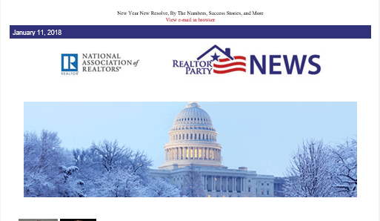
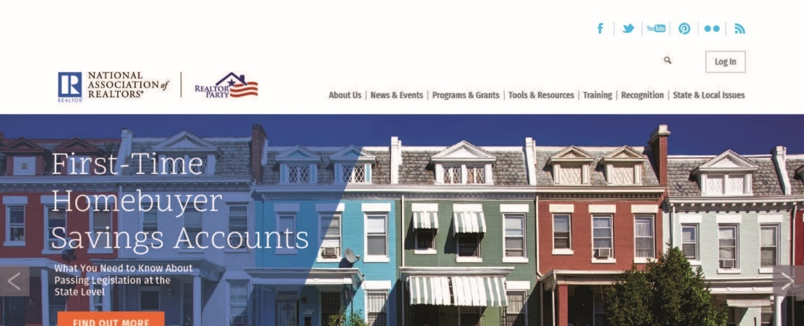

Stay Connected to the
REALTOR® Party
#REALTORParty
REALTOR® Party News
Facebook
Twitter
Instagram
REALTORParty.realtor
Notes:
I urge you to stay connected to the REALTOR® Party through:
The REALTOR® Party News – an email newsletter that goes out to ALL NAR members on the second Thursday of every month. In that newsletter, you’ll see the many ways that the REALTOR® Party is working across America.
Follow us on Facebook, Twitter, and Instagram and tag us in your posts (@NARRealtorParty) or use the hashtag #REALTORParty.
And visit us at www.realtorparty.realtor to learn more about our programs, services and resources and read stories about REALTORS® in action across the country.

Slide 16

You are the
REALTOR® Party!
www.realtorparty.realtor
Notes:
You are the REALTOR® Party.
We need you to be involved. Vote, Act, Invest to make the REALTOR® Party strong and effective. You can make a difference in our community and in our country.

